Slide 1

Welcome to
Frontend Web Development Basics

Slide 2
Sesi 5

Slide 3
CSS Framework
BOOTSTRAP
http://getbootstrap.com/getting-started/.

Slide 4
Other framework
Semantic
Foundation
Material UI

Slide 5
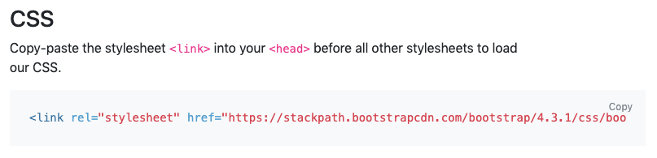
Using Bootstrap
ONLINE

Slide 6
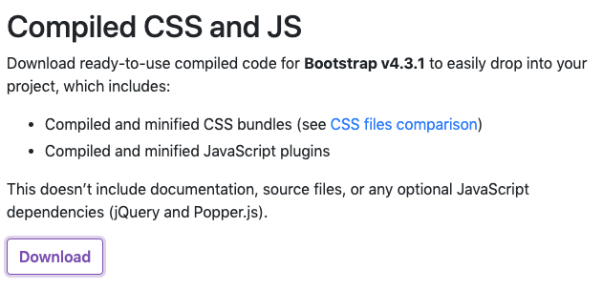
Using Bootstrap
OFFLINE (DOWNLOAD)

Slide 7
12 = 100%
12/2 = 6 (50%)
12/4 = 3 (25%)

Slide 9
Using Font Awesome
https://www.bootstrapcdn.com/fontawesome/

Slide 10
EXCERCISE TIME!

